Slide 1
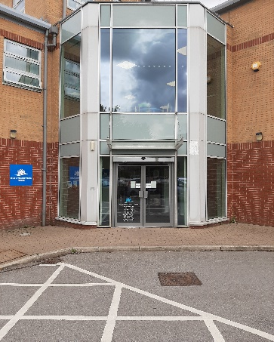
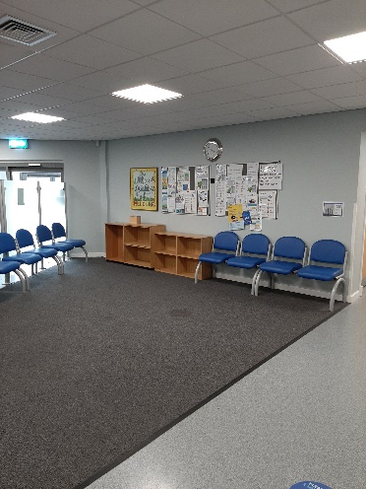
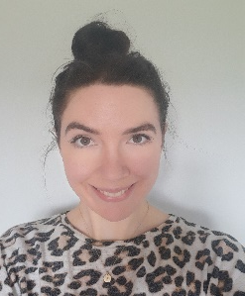
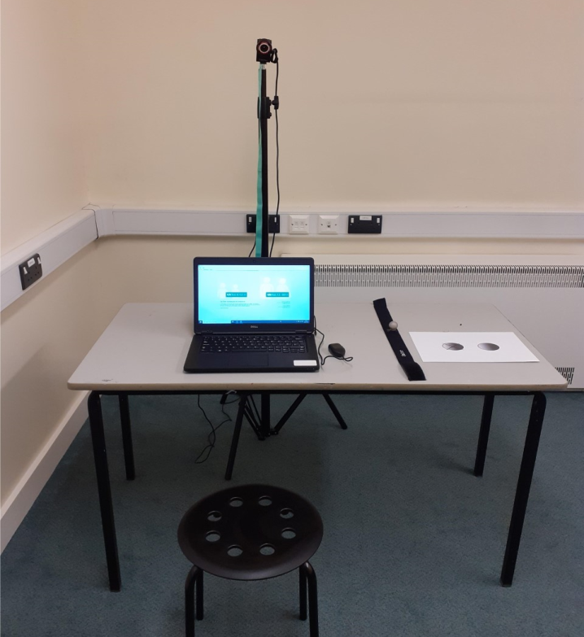
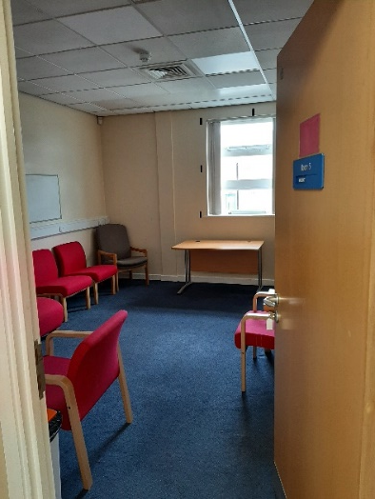
1
2
3
One of these people will come out to meet you:
Abbie
This is Parkside Health Centre.
Enter through the main entrance and go to reception
You will then wait in the waiting room for your appointment
Katharine
Rhian
4
5
6
When you come into the room you will see:
Laptop
Camera
Clicker
Picture card
Chair
Headband
We will take you to our room

Slide 2
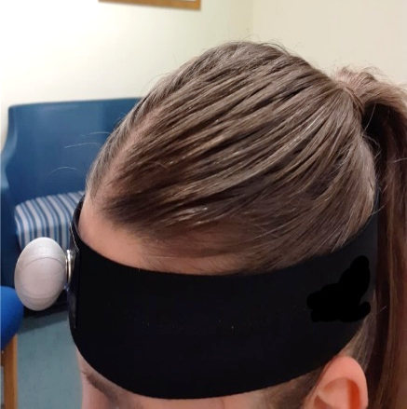
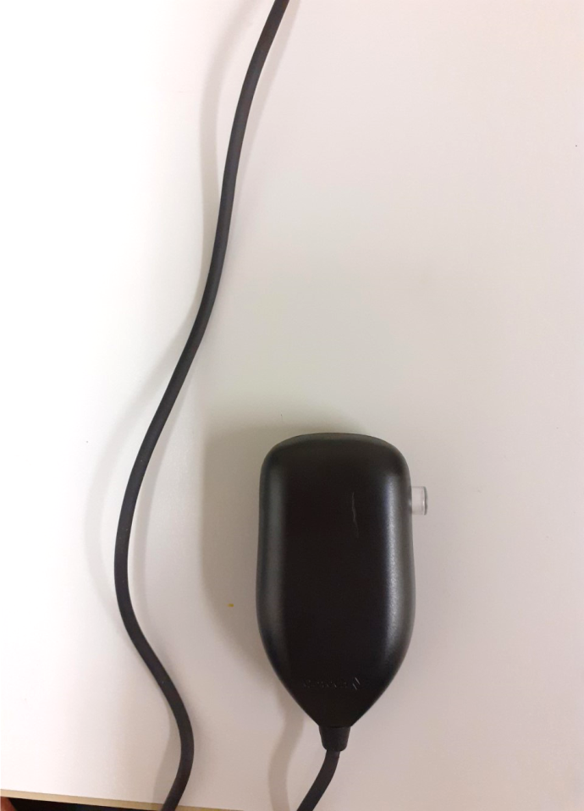
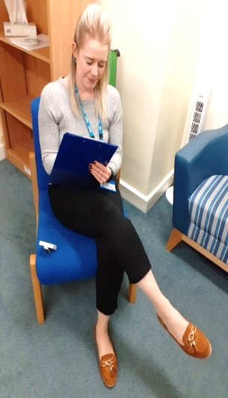
7
8
9
This is a sensor that connects to the headband. It is used to follow your movement.
You will use this clicker which has a button on the front.
This is a Velcro headband, which is in a plastic sleeve.
It will go around your head like this.
Don’t worry this doesn’t hurt
10
11
12
Some people find the activity hard, whereas others find it easy.
All we ask is that you give it a try!
We will ask you to do a computer based activity.
Whilst you’re doing this we will be sitting quietly making notes.
When you have finished we will take you back to the waiting room.

